Slide 1

Department of Mechanical Engineering Indian Institute of Technology Tirupati
B. Tech Final Year Project Presentation
DESIGN AND FABRICATION OF EXPERIMENT FOR DYNAMIC ANALYSIS OF MECHANISMS
Aakash (ME16B001)
A. Akhil (ME16B003)
Supervised by
Dr. Sriram Sundar, Assistant Prof of ME
Date: 17-OCT-2019

Slide 2

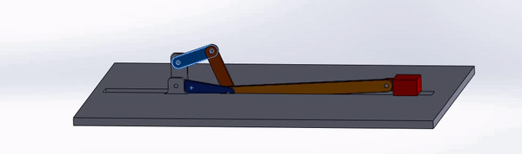
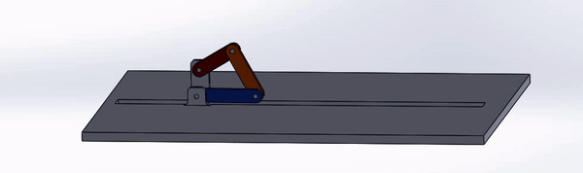
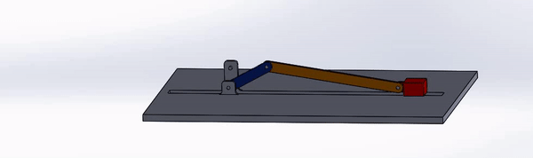
Objectives and Motivation
Dept. of Mechanical Engineering
B. Tech Final Year Project Presentation
Introduction - Design and fabrication of experimental setup for static, kinematic and dynamic analysis of mechanism with retrofitted parts to facilitate multiple experiments in the same setup.
Motivation - The experiment will supplement and reinforce the theoretical understanding of the undergraduate students taking the course ME2206(KDM).
Notes:
by providing them the opportunity to match the analytical results with the actual experimental results.

Slide 3
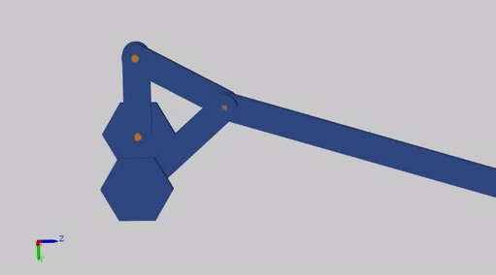
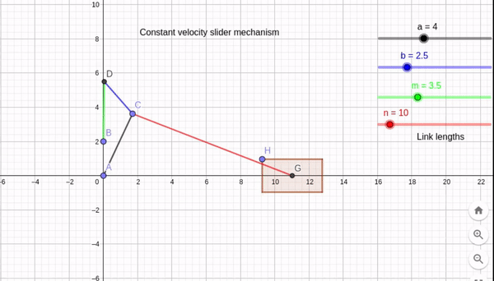
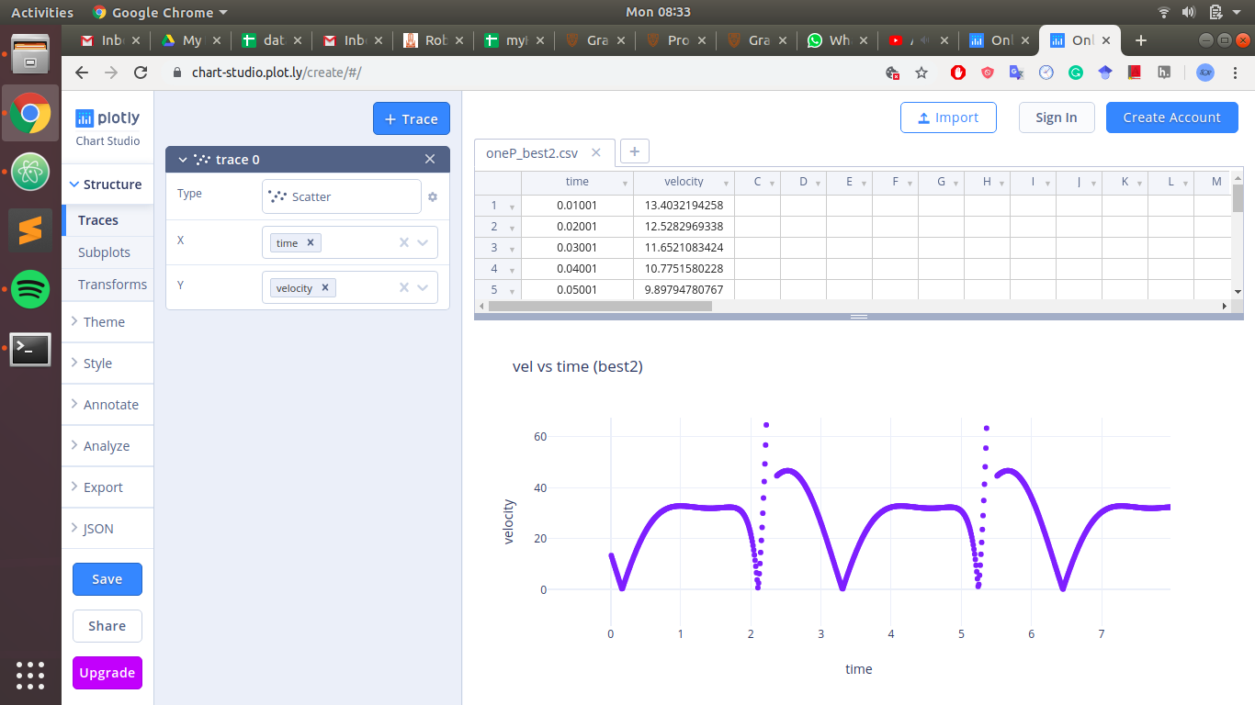
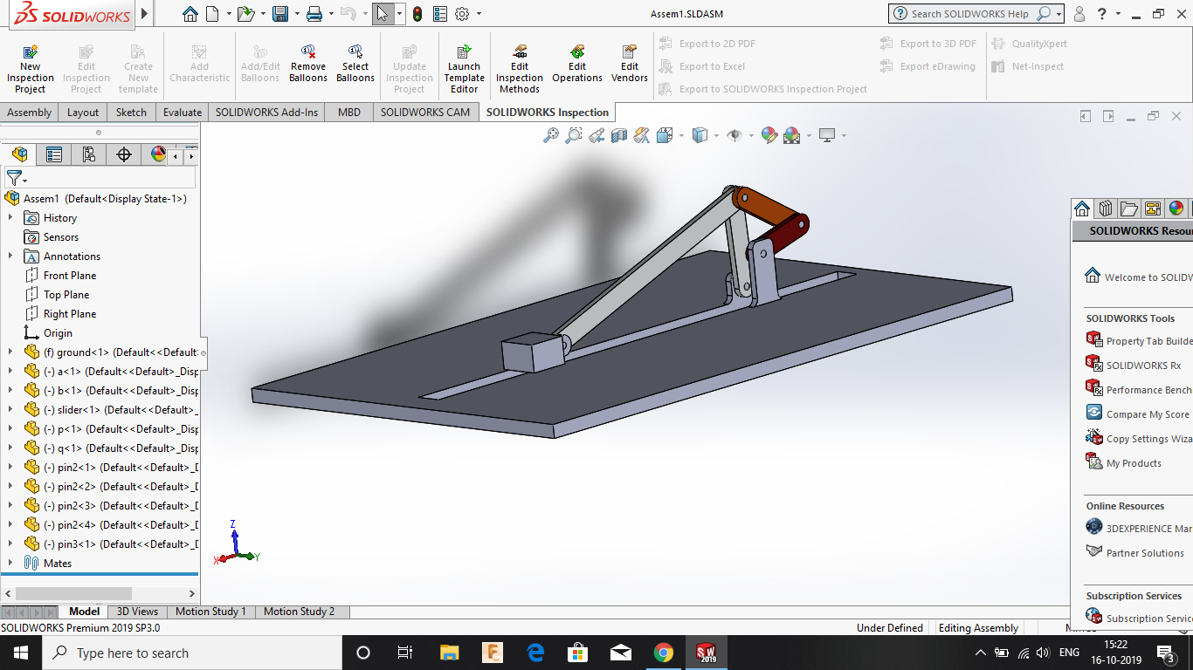
Updates
Dept. of Mechanical Engineering
B. Tech Final Year Project Presentation
GeoGebra
Python
Simscape
Solidworks
Velocity (unit/s) vs time
Notes:
3D Modelling of the system with realistic dimensions to assist in fabrication and final designing.
Dynamic analysis of mechanism carried out in simscape(MATLAB).
Iterations were carried out in order to come up with a constant velocity mechanism having least variation
Preliminary kinematic analysis of mechanism.

Slide 4
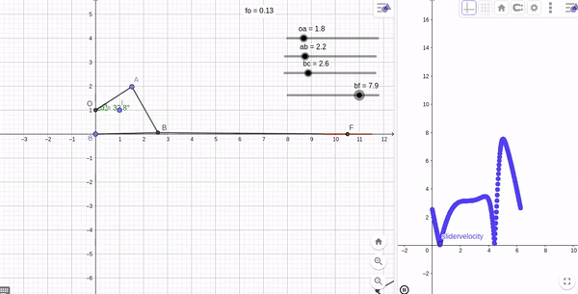
Kinematic Analysis
Dept. of Mechanical Engineering
B. Tech Final Year Project Presentation
By using Geogebra, we got preliminary link lengths and slider velocity profile.
Analysed the velocity profile by changing link lengths.

Slide 5
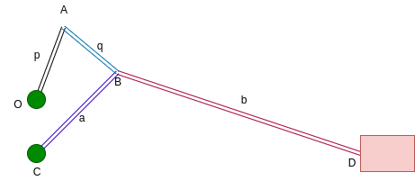
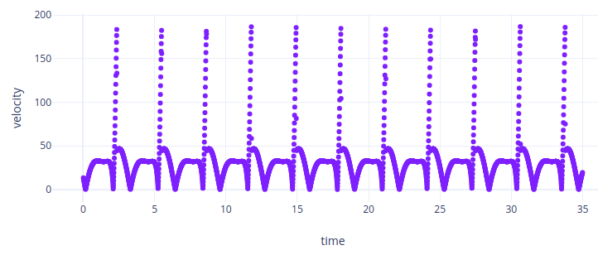
Design for constant velocity
Dept. of Mechanical Engineering
B. Tech Final Year Project Presentation
Iteration over length a,b,p,q
Obtained length ratios for minimal velocity variation
a | b | p | q
26 | 79 | 18 | 22
Velocity (unit/s) vs time

Slide 6
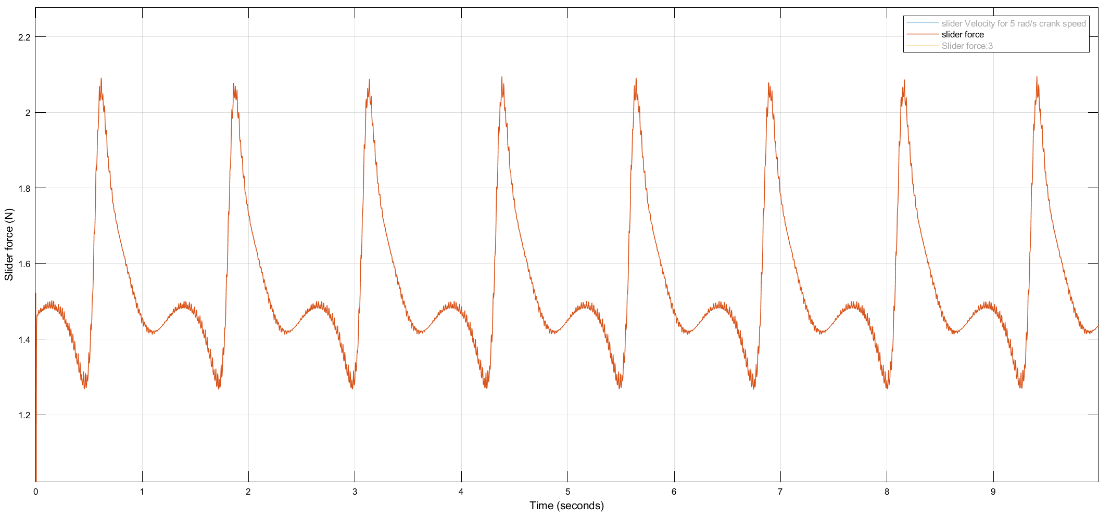
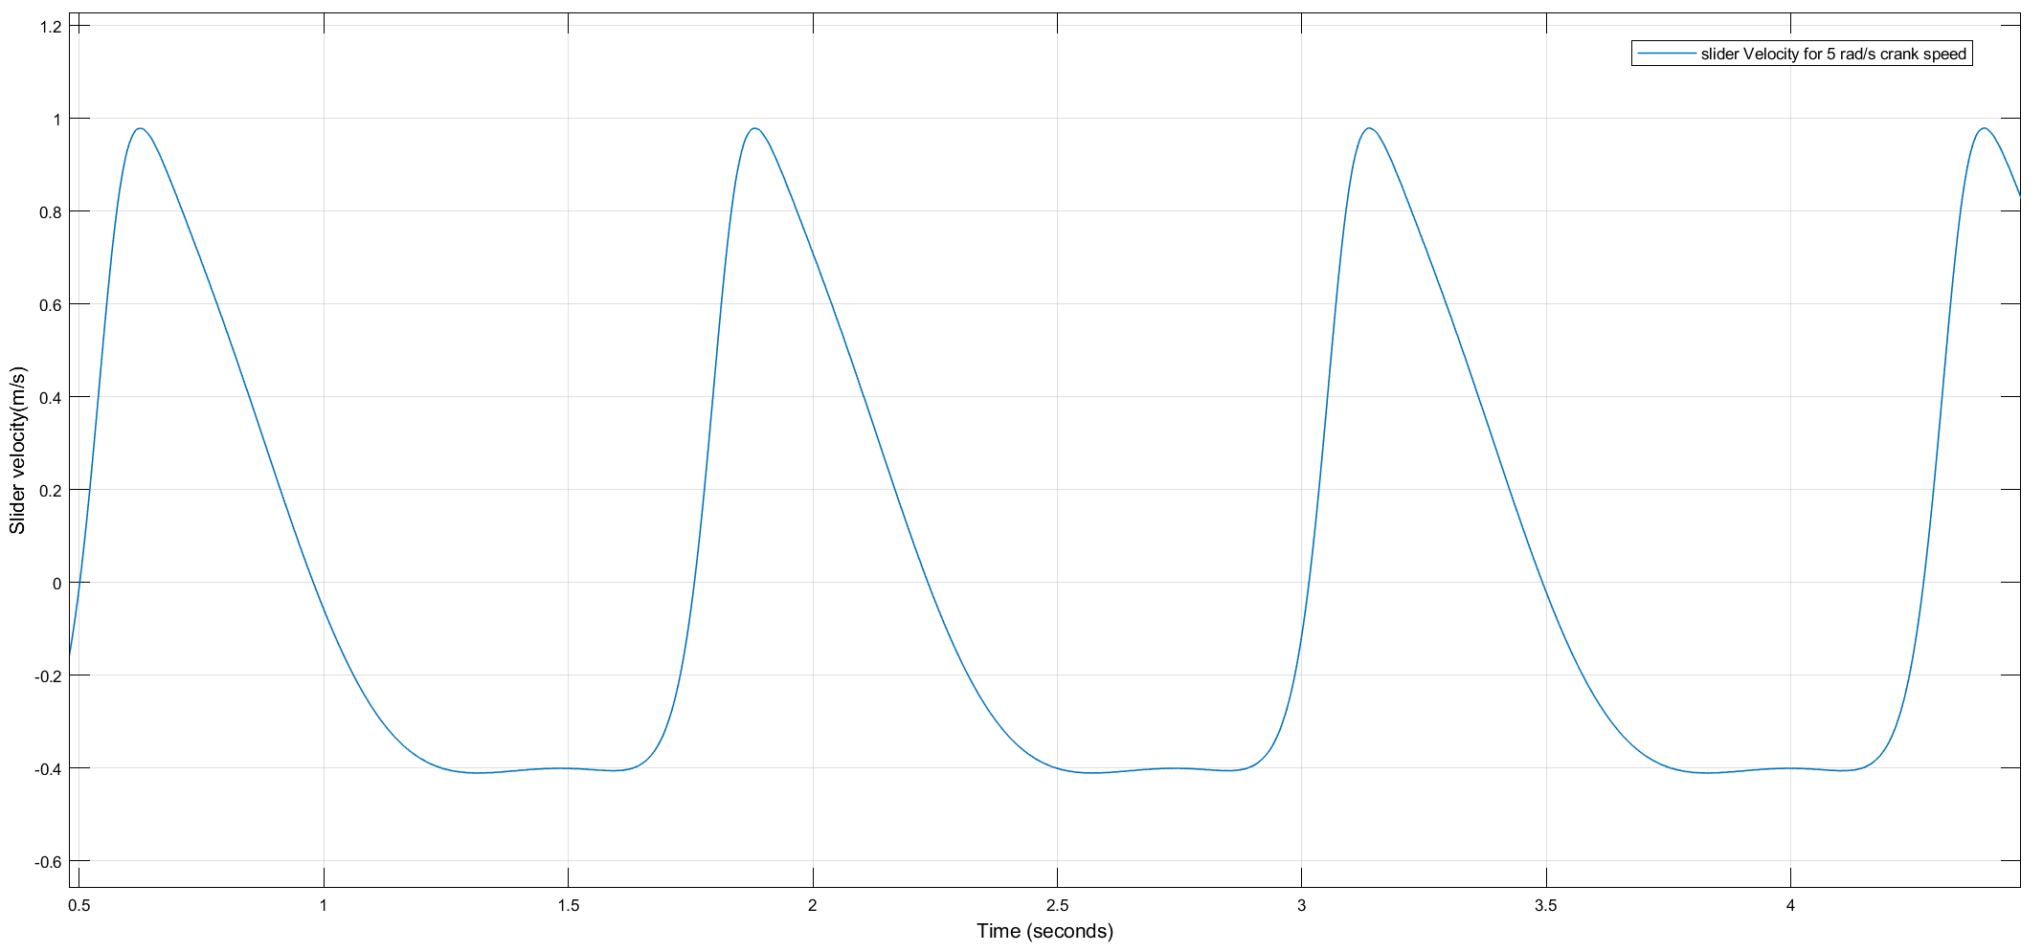
Dynamic Analysis
Dept. of Mechanical Engineering
B. Tech Final Year Project Presentation
Dynamic and kinematic analysis helps in designing mechanism which is suitable for taking measurements.

Slide 7
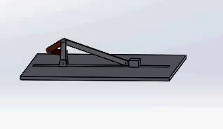
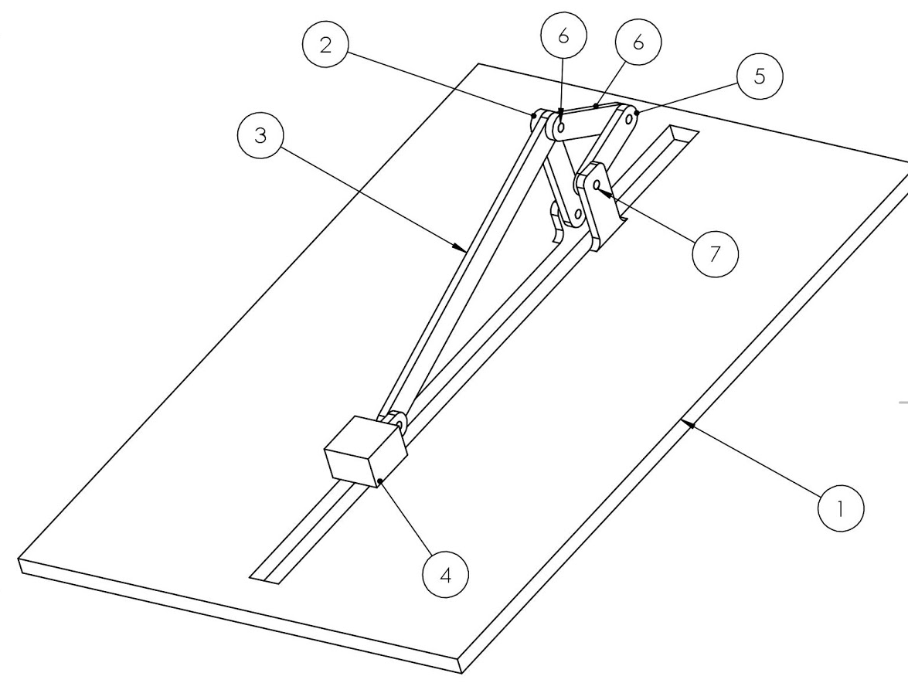
3D Model
Dept. of Mechanical Engineering
B. Tech Final Year Project Presentation
Part number | Part Name
1 | Ground
2 | Link a
3 | Link b
4 | Slider
5 | Link p
6 | Link q

Slide 8
Cost Analysis
Dept. of Mechanical Engineering
B. Tech Final Year Project Presentation
₹25,000
₹10,000
₹10,000
Sensing
Actuation
Fabrication
Rotary Encoders
Linear Accelerometers
Position measurement
Control board
Data Acquisition System
Variable speed motor
Bearings
Gears
Polished Aluminium
Machining
Miscellaneous
Grand Total: ₹45,000

Slide 9
Future Work
Dept. of Mechanical Engineering
B. Tech Final Year Project Presentation
Sensors Identification
Final Design
Fabrication
Identification of sensors based on the range of the parameter outputs in the simulations.
Setting up of the controller or the DAQ.
Final Prototype model which consists of links, bearings, motors, sensors, etc.
Fabrication and assembling of links.
Experimentation and Testing.

Slide 10
Supplementary material

Slide 11
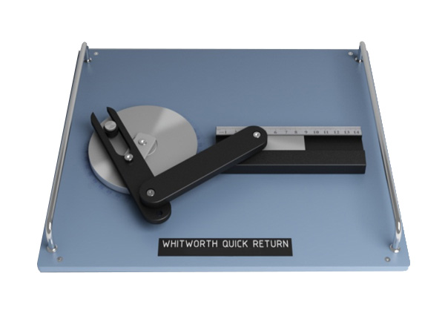
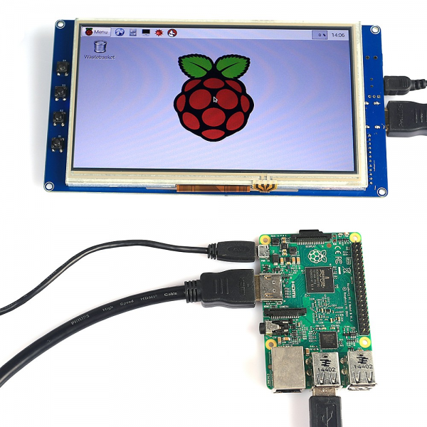
Introduction and Objectives
Dept. of Mechanical Engineering
B. Tech Final Year Project Presentation
To design and fabricate an experimental setup for static, kinematic and dynamic analysis of mechanism.
The setup will have retrofitted parts in order to let the student carry out multiple experiments in the same setup.
The experiment will supplement and reinforce the theoretical understanding of the undergraduate students taking the ME2206(KDM) by providing them the opportunity to match the analytical results with the actual experimental results.
source: ardubotics.com
source: sun labtech
Notes:
The field and/or area in which you will be working
(b) The aim and objectives of your work.
(c) The importance of your work and its applications

Slide 12
Plan
Dept. of Mechanical Engineering
B. Tech Final Year Project Presentation
Theoretical analysis
3D Modelling
Documentation
GeoGebra Modelling and sensor identification
Prototyping, Fabrication and Testing
Estimated budget : INR 25,000.00 - 30,000.00
Probable sensors for instrumentation: Rotary encoders, Ultrasonic range sensors, linear accelerometers, strain gauges

Slide 13

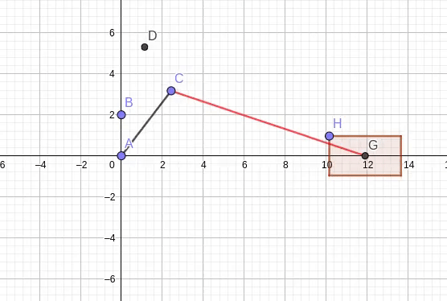
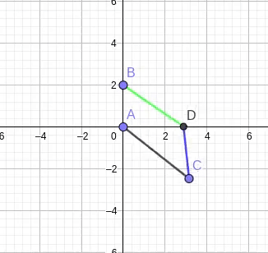
Mechanism
Dept. of Mechanical Engineering
B. Tech Final Year Project Presentation

Slide 14
Literature Review
Dept. of Mechanical Engineering
B. Tech Final Year Project Presentation
Kinematics and Dynamics of Machinery, Robert L. Norton
Theory of Mechanisms and Machines, Ghosh and Mallik
Theory of Machines and Mechanisms, Uicker, Pennock and Shigley

